Slide 1


July 2022
CSJ Writers

Slide 2
Tasks
July 2022
CSJ Writers

Slide 3
Tasks
Story
Part 3: Film Treatment
Deliverables: Film Treatment and Presentation of Film Treatment
Blogs
Research and write 10 blogs (500 - 750 words) each over the course of the 8 weeks
Will be broken down into research in the first 4 weeks followed by writing in the last 4 weeks

Slide 4
Film Treatment
A film treatment…
Is a document the presents the story before a full script is written
They are/have..
Present tense
Narrative like
Highlight important information about the story
Title
Story summary
Logline/premise
Character descriptions (completed prior)

Slide 5
Film Treatment
Expectations..
Set up the world
What is the name of the planet we travel to?
What is the main conflict?
How does the hero learn/gain their abilities
Overall story structure
Roadmap of the journey (break into acts of the story to present)
Epilogue
Key characters and the roles they play, outside of the protagonist/antagonist (ex. Mentors, giants, etc.)

Slide 6
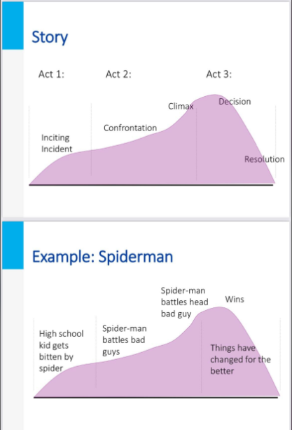
Story Requirements
Treat the story as the first movie in a trilogy
Provide enough closure for it to be a self contained story but allow for room to develop another antagonist for a sequel/second series
Develop thorough main protagonist(s) and antagonist(s)

Slide 7
Additional Resources
On Film Treatment writing:
https://www.masterclass.com/articles/how-to-write-a-film-treatment-in-6-steps#how-to-write-a-treatment-in-6-steps

Slide 8
8 Week Roadmap
July 2022
CSJ Writers

Slide 9
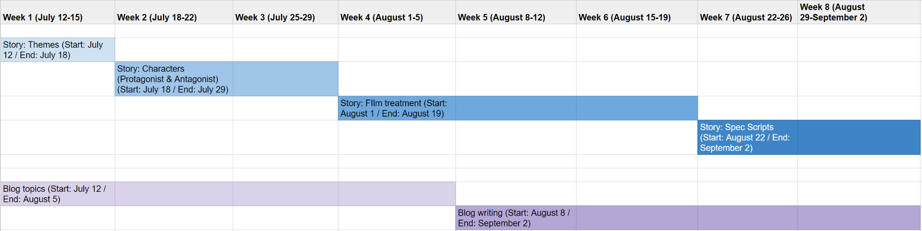
Roadmap

Slide 10
Task Start/End
*Dates may be adjusted as we work through the summer
Tasks | Start Date | End Date
Story: Themes | July 12 | July 18
Story: Characters | July 18 | July 29
Story: Film Treatment | August 1 | August 19
Story: Spec Scripts | August 22 | September 2
Blog: Topics Research | July 12 | August 5
Blog: Writing | August 8 | September 2

Slide 11
Thank You
July 2022
CSJ Writers

